Slide 1


Python^{3.7}

Slide 2
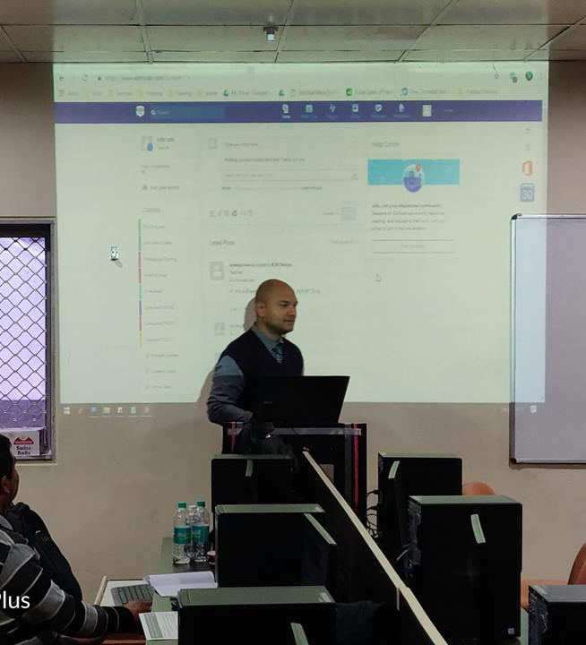

Trainer Profile
Technical Evangelist
Helping developers understand python, app building e.t.c
Microsoft Certified Trainer
My first program was written in basic on a computer with 64K of memory
Decade of a coding experience
C/C++, VB, C#, Java, Python
Frequent blogger and presenter!

Slide 3
Agenda
Python Essentials- Day 1
01 | Getting started with Python | 05 | Strings
02 | Environment Setup | 06 | Exercises
03 | Hello World | 07 | Summary
04 | Basic Data Structures

Slide 4

An Interpreted , Interactive , Object-Oriented Programming Language.

Slide 5
Features of Python
Multipurpose – Can be used Web, GUI, Scripting etc.
Object Oriented
Interpreted
Focus on readability and productivity
Batteries Included – a Total of 98,524+ Modules available.
Interactive Shell
Cross Platform

Slide 6
Use Python for
Web Development: Django, Pyramid, Bottle, Tornado, Flask, web2py
GUI Development: tkInter, PyGObject, PyQt, PySide, Kivy, wxPython
Scientific and Numeric: SciPy, Pandas, Ipython
Software Development: Buildbot, Trac, Roundup
System Administration: Ansible, Salt, OpenStack

Slide 7


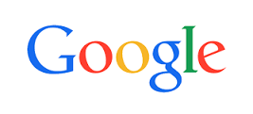


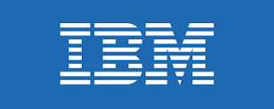
Who Uses Python?

Slide 8
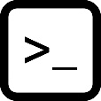
Practical Lab
hisss…ss…
Lets Python!

Slide 9
Summary
Python is a popular programming language.
It is used for:
web development (server-side),
software development,
mathematics,
system scripting.
What can Python do?
Python can be used on a server to create web applications.
Python can connect to database systems. It can also read and modify files.
Python can be used to handle big data and perform complex mathematics..
Why Python?
Python works on different platforms (Windows, Mac, Linux, Raspberry Pi, etc).
Python has a simple syntax similar to the English language.
Python has syntax that allows developers to write programs with fewer lines than some other programming languages.

